Slide 1
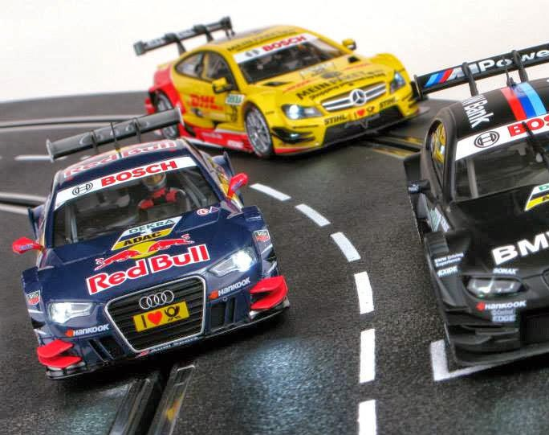
Using HTM to Perform Misbehavior Detection in Autonomous Vehicle Platoons
Ethan Swistak and Tushar Singhal

Slide 2
Week 2 – Progress Summary
Completed This Week | To-Do
Gathered prototype dataset. Automated data generation process, possible to run 100’s of trials.(but we currently only have 3). Performed some initial visualizations. Tested HTM model on example dataset and obtained anomaly scores. | Run NUPIC on anomaly data, we may need to tweak the process to show more realistic/noticeable anomalies. Finalize hyperparameters for data generation. Gather a much larger dataset for training testing.

Slide 3
Data Generation Process
run a platoon with 3 cars
Each trial is for a set amount of time, currently 120 seconds
We wait a random interval between 40-80 seconds before starting an attack, an attack is focused on a random vehicle
The attack is either jamming or data injection
After 10-30 seconds the anomaly ceases
We record position, velocity, and acceleration of each car(motion object)
The model must take this data and use it to predict when an attack occurred

